Slide 1
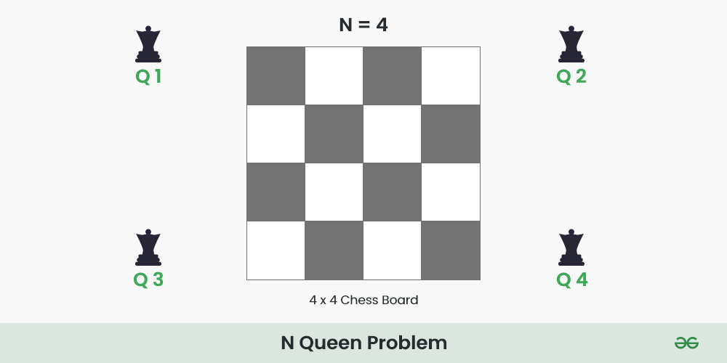

N-Queens Visualizer Using Backtracking Algorithm
By: Pariyank Sikarwar

Slide 2


Introduction to N-Queens Problem
What is the N-Queens Problem?
The N-Queens problem involves placing N queens on an N×N chessboard such that no two queens can attack each other. This means no two queens can be in the same row, column, or diagonal.

Slide 3

Rules of the N-Queens Problem
Queen's Movement: In chess, a queen can move any number of squares along a row, column, or diagonal.
Constraints:
No two queens can be in the same row.
No two queens can be in the same column.
No two queens can be in the same diagonal.

Slide 4
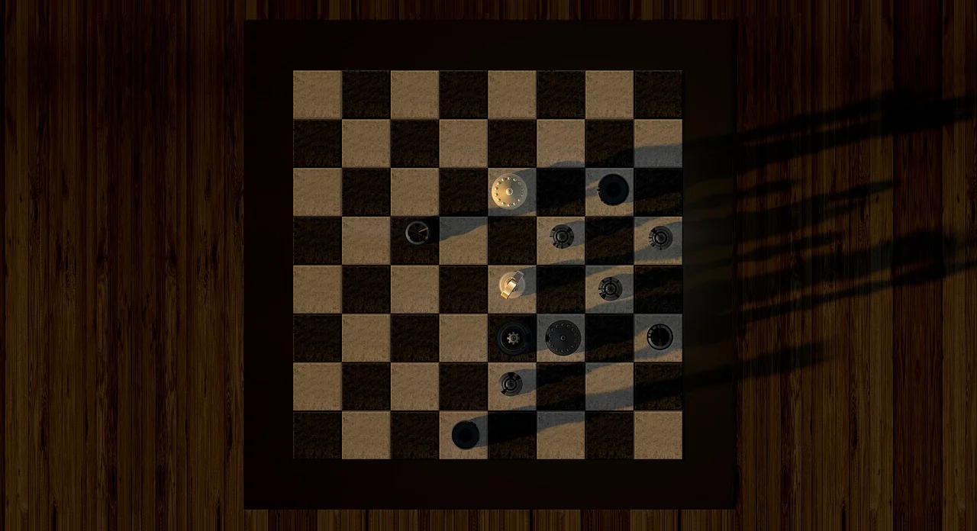
Introduction to Backtracking
What is Backtracking?
Backtracking is a general algorithm for finding all (or some) solutions to computational problems, notably constraint satisfaction problems. It incrementally builds candidates to the solutions and abandons a candidate ("backtracks") as soon as it determines that the candidate cannot possibly be completed to a valid solution.
Key Concepts:
Recursive Approach: The algorithm tries to build a solution recursively, one piece at a time.
Backtrack: If the current partial solution is invalid, it backtracks to the previous step and tries a different path.

Slide 5

01
Place a queen in the first column of the first row.
Move to the next row and place a queen in the first available column where it is not attacked by any previously placed queens.
How Backtracking Solves N-Queens
02
03
If no valid position is found in a row, backtrack to the previous row and move the queen to the next valid position.
04
Repeat until all queens are placed or all possibilities are exhausted.

Slide 6

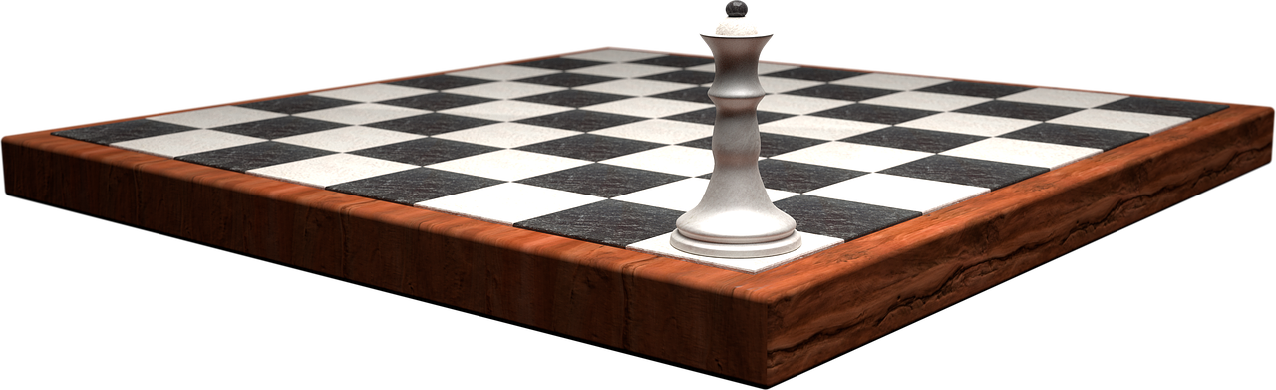
THANK YOU!

